Slide 1

U.S. Rotary CLUB & District Liability Insurance Program
July 2021 Risk Management

Slide 2
Overview:
  What is the Program?
  Who is Covered?
  What Insurance Coverages Are Provided?
    General Liability
    Directors & Officers / Employment Practices Liability
  Insurance Limitations & Exclusions
  Incident Reporting
  Resources
Overview
The following are topics to be discussed during the presentation to help you better understand the insurance coverage provided.

Slide 3
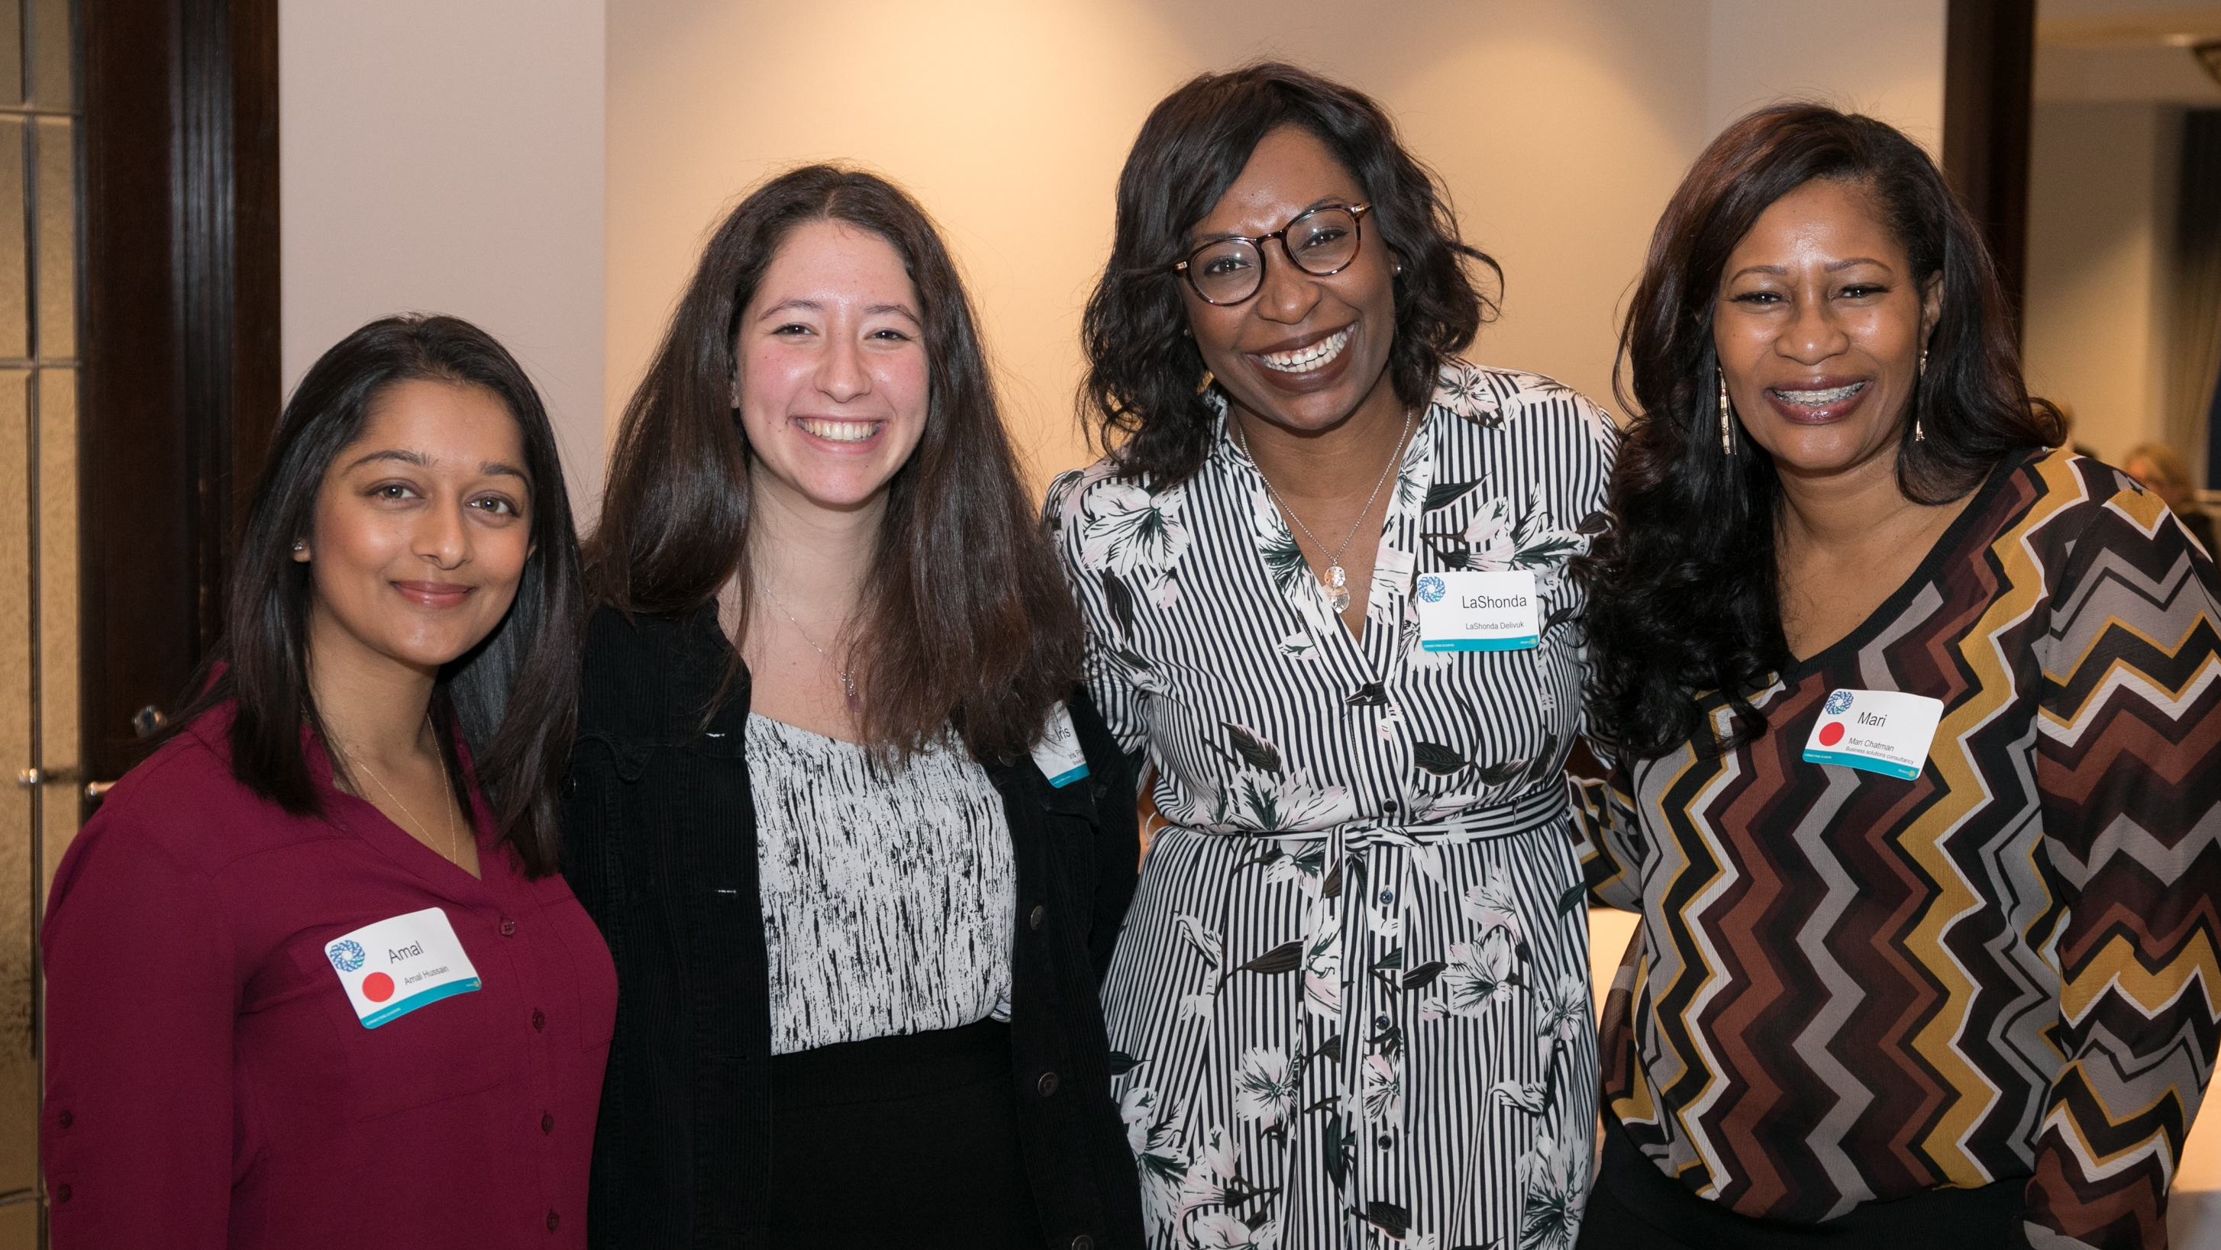
subhead
What is The Program?
The U.S. Rotary Club & District Liability Insurance Program (‘Program’) provides liability insurance to all active U.S. Rotary Clubs & Districts.
The insurance program is financed by U.S. Rotarians – via insurance assessments to RI on the 1 July Club Invoice (annual charge in July).
Notes:
The U.S. Rotary Club & District Liability Insurance Program (‘Program’) provides liability insurance to all active U.S. Rotary Clubs & Districts and Rotaract Clubs. The insurance program is financed by Rotarians – via insurance assessments to RI on the 1 July Club Invoice (annual charge in July).

Slide 4
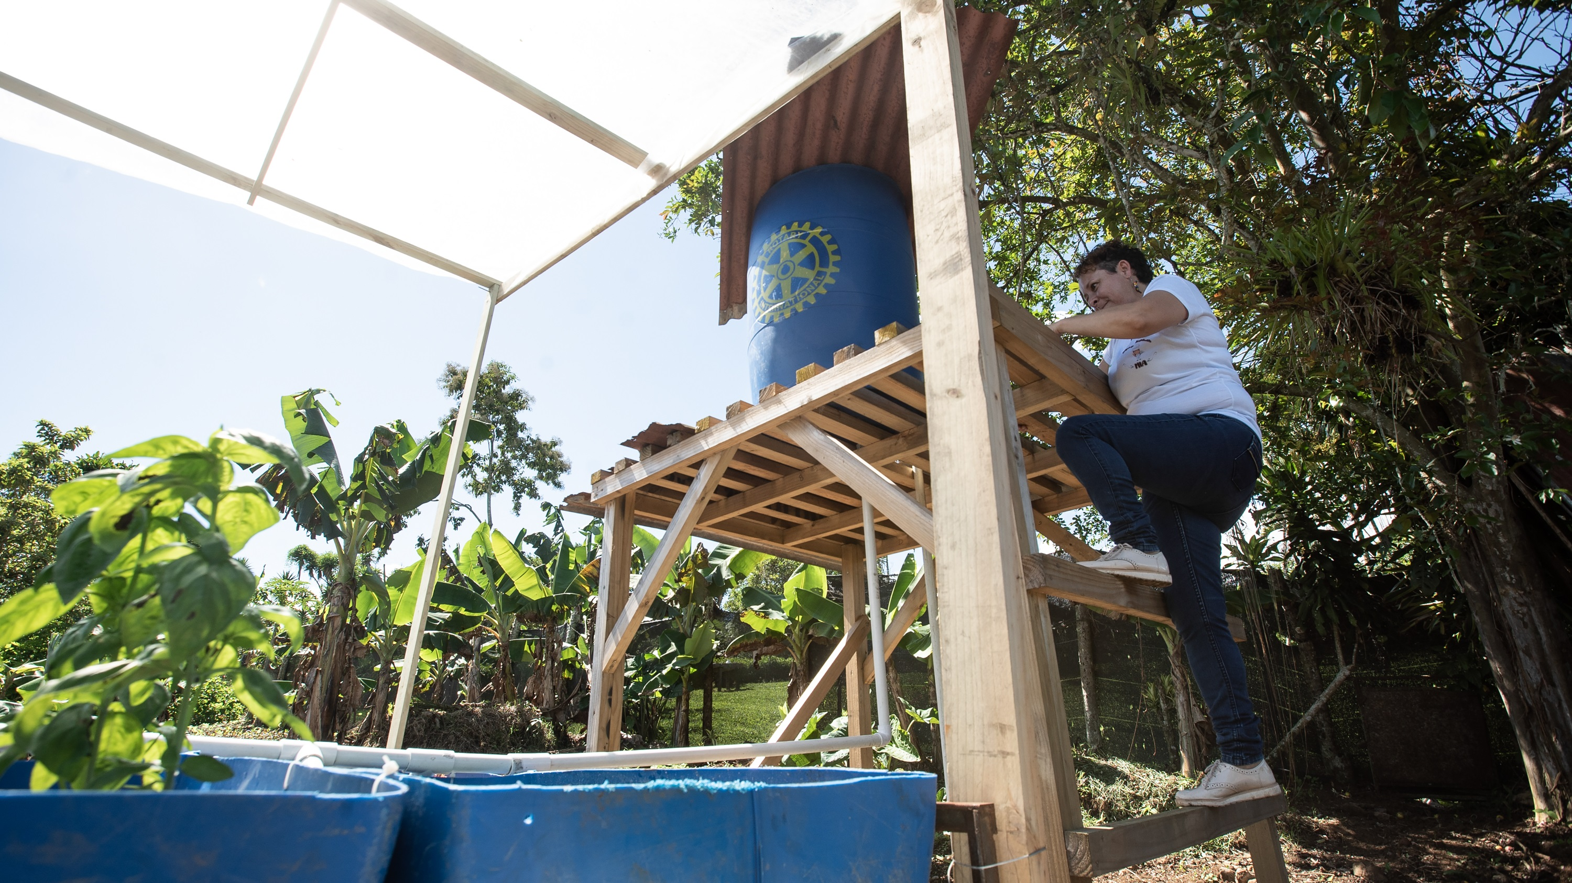
What coverages are provided?
Understand General Liability and Directors & Officers & Employment Practices Liability Coverages

Slide 5
Coverages under General Liability:
Bodily Injury and Property Damage
Sexual Misconduct Liability (SML)
Liquor Liability
Non-Owned / Rented Auto Liability
Medical Payments (Med Pay)
Personal and Advertising injury which includes copyright infringement
General Liability
Protects Rotary clubs and districts against liability claims for bodily injury to a third party and damage to a third party’s property.
Common Coverages under General Liability:
  Personal and Advertising injury which includes copyright infringement
  Liquor Liability
  Medical Payments (Med Pay)
  Non-Owned / Rented Auto Liability
  Abuse and Molestation
Notes:
General Liability protects Rotary clubs and districts against liability claims for bodily injury to a third party and damage to a third party’s property. This insurance is typically required by a lessor/municipality when a Rotary club or district holds events, fundraisers, or other activities.
Abuse and Molestation: The Program provides Sexual Misconduct Liability coverage on a claims-made basis to protect clubs and districts from claims arising out of alleged sexual misconduct and molestation. Sexual misconduct means sexual molestation, including but not limited to, any unwanted sexual involvement, sexual conduct or sexual contact.
Liquor Liability for damages to a third party arising from the selling, serving or furnishing of alcoholic beverages. Coverage is included for a club/district that is selling, serving, or furnishing alcoholic beverages.
Non-Owned/Rented Auto Liability for the use of hired, leased, borrowed, or non-owned autos. This coverage responds after any insurance carried by the owner/operator of the vehicle is exhausted. This excess coverage is intended for insured entities only and does not extend to individual auto owners.
If the Rotary club/district owns an auto, it must be separately insured by the club.
There is no comprehensive or collision coverage for damage to any auto operated by the club/district.
Note: The coverage territory for non-owned/hired auto liability coverage is limited to the U.S., its
territories and possessions, and Canada.
Medical Payments (Med Pay) is a type of no-fault coverage for bodily injury. This coverage pays for medical expenses incurred by a third party for an injury sustained while not admitting fault. The Program excludes medical payments for persons injured while practicing, instructing or participating in any athletic events or activities.
Personal and Advertising injury includes copyright infringement in your “advertisement”. “Advertisement” means a notice that is broadcast or published to the general public including material placed on the internet.

Slide 6



General liability
What entities are covered?
Rotary Clubs
Rotary Districts
Rotaract Clubs
and also …
  Rotary Club Foundations
  Rotary District Foundations
  Interact Clubs
  Rotary Community Corps
  Certified Youth Exchange Organizations
  Rotary Youth Leadership Awards (RYLA)
  President Elect Training Seminar (PETS)
Notes:
These are the Rotary entities that are covered by this insurance program.
Any Rotary affiliated entities not shown here are likely NOT covered.
Also, any separate legal entities created by a Club or District are NOT covered, with limited exceptions for foundations that meet specific criteria for coverage.
Please check with Rotary’s Risk Management if you are not sure whether an entity is insured under the Program.

Slide 7
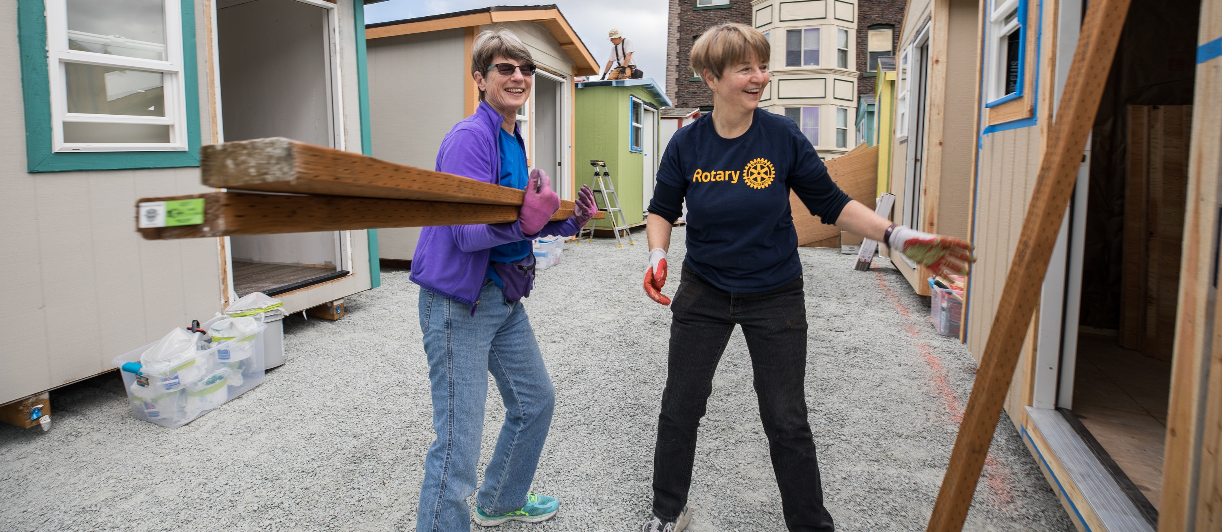
General liability
WHO IS COVERED?
Protects volunteers & Rotarians, as insureds, with respect to their liability for acts within the course and scope of their duties on behalf of a Rotary Club or District.
Notes:
Individuals, such as Rotarians and volunteers, are also covered. However, coverage for such individuals is limited to acts within the course and scope of their duties on behalf of a Rotary Club or District (or other insured Rotary entity).
Remember that this is liability coverage, which applies when a third party has a liability claim for that third party’s bodily injury or property damage. If a Rotarian or volunteer is injured, it is expected that their health insurance is available to them. There is no coverage for a Rotarian’s or volunteer’s personal property that is damaged, destroyed, or stolen.
Lastly, there are other limitations that restrict coverage to individuals. Some coverage limitations are based on requirements that an individual carry their own personal insurance (such as auto insurance required by State law) or that some actions are uninsurable, such as when an individual intentionally injures someone or commits a criminal act.

Slide 8
  Abuse and Molestation: The Program provides Sexual Misconduct Liability coverage on a claims-made basis to protect clubs and districts from claims arising out of alleged sexual misconduct or molestation. Sexual misconduct means sexual molestation, including but not limited to, any unwanted sexual involvement, sexual conduct or sexual contact.
  Claims-made coverage is limited to claims that are first made against an insured during the policy period and timely reported to the insurer. This means that any sexual misconduct incidents must be immediately reported to RI Risk Management – even if you do not anticipate a claim arising out of the incident.
Sexual misconduct liability (SML)

Slide 9

subhead
Property damage & bodily injury
General Liability insurance protects Rotary clubs and districts against liability claims for bodily injury to a third party and damage to a third party’s property.
Notes:
Commercial general liability insurance is issued to business organizations to protect them against liability claims for Bodily Injury (BI) or Property Damage (PD) arising out of premises, operations, products, and completed operations.

Slide 10

subhead
Liquor liability
The Program provides liquor liability coverage for bodily injury or property damage to a third party arising from the selling, serving or furnishing of alcoholic beverages, subject to policy terms and conditions. It is expected that all applicable laws be followed, including ensuring proper licensing with all applicable governmental bodies.
Notes:
Liquor liability is shown on the Certificate of Insurance, so a special request to add or include it is not needed.
When possible, use a third-party vendor to provide and sell/distribute liquor for/at your club and district events. In your agreement, require the vendor to carry liquor liability coverage and request that your club/district be added as additional insured on their policy ($1M minimum limit) and require that the vendor provide you with a certificate of insurance.
When a third-party vendor is not used, please have any Rotarian or volunteer selling/distributing alcohol at the event be familiar with Training Intervention Procedures (TIPS) or an equivalent program. TIPS is a program designed to teach serving alcohol responsibly. Additional information can be found at www.gettips.com.

Slide 11

subhead
Non-owned & rented autos
The Program provides excess liability coverage for the use of rented and non-owned autos, above any other valid and collectible insurance on the auto.
When a trailer is attached to a vehicle, the vehicle owner’s insurance is primary.
Notes:
The Program provides non-owned and rented auto liability coverage to U.S. Rotary clubs and districts for liability arising from use of non-owned and rented autos in the course and scope of insured activities. Coverage is provided for third party bodily injury and property damage claims only. The coverage for insured entities is excess over any other insurance available to the owner/driver and excludes coverage for physical damage (comprehensive and collision). This excess coverage protects the Rotary club/district (not the driver or auto owner) when the auto owner or driver’s primary policy limits are insufficient or have been exhausted.
Non-Owned & Rented Auto Liability coverage will always pay in excess of any insurance coverage already on the vehicle. It does NOT cover the owner of the automobile. If an individual Rotarian is involved in an auto accident while driving their personal owned auto on Club or District business, no insurance coverage is provided to the individual; however, there might be coverage for the Club or District if they’re sued by the person injured in the auto accident.
When renting a vehicle for club or district use (including on behalf of Interact, RYLA, etc.) the club or district should elect appropriate insurance coverage through the rental agency. The Program provides excess coverage for rented (and non-owned) autos, above any other valid and collectible insurance on the rented auto. No coverage is provided for damage to the rental vehicle itself. This non-owned and rented auto insurance coverage does not apply in Mexico.
This insurance does NOT provide coverage for any automobiles owned by the Club or District.
A “trailer” is included in the definition of "auto" in the insurance policy. When a trailer is attached to a vehicle, the vehicle owner's insurance is primary. If the trailer is not owned by the club/district, the Program provides excess coverage above the vehicle owner’s insurance policy limit subject to policy terms and conditions. The Program does not provide excess coverage if the trailer is owned by the club/district as the Program does not cover owned auto liability. No coverage is provided for damage to the trailer itself.

Slide 12

Medical payments
This coverage pays for medical expenses incurred by a third party for an injury sustained while not admitting fault.
The Program excludes medical payments for persons injured while practicing, instructing or participating in any athletic events or activities.

Slide 13

subhead
Personal & advertising injury
Personal and Advertising injury includes copyright infringement in your “advertisement”. “Advertisement” means a notice that is broadcasted or published to the general public including material placed on the internet.
Notes:
When your club/district uses songs, photographs, poems, illustrations, charts, videos, or graphs in presentations, club/district websites, online or in newsletters, you must obtain a license or permission from the owner prior to use. This includes any songs, photos, etc. you find on the Internet or created by a Rotary club member. Spend time trying to identify the copyright owner and if you do not have permission from the owner, do not use it.
Look for organizations that provide public copyright licenses (Creative Commons), open access images or royalty free licenses. Paying a small fee to use an image is preferable to your club receiving a copyright infringement demand letter. Consult an attorney for assistance in determining copyright ownership. Please know that “fair use”, a defense to copyright infringement, generally applies to commentary, criticism and parody, and does not appear to apply to a Rotary Club’s activities and promotions.
If you are using a photograph, video or other recording that includes the image or any personal data of any recognizable person, you must obtain permission from each person (or the parent or guardian of any minor child) before using that photograph, video or other recording.

Slide 14
Directors & Officers Liability (D&O)
Employment Practice Liability (EPL)
Provides coverage for claims made against club and district directors and officers for liability arising out of the performance of their duties, such as allegations of mismanagement of funds or failure to enforce bylaws.
Provides coverage for claims arising out of club and district employment related practices.
Does not cover bodily injury or property damage.
Common Coverages under General Liability:
  Personal and Advertising injury which includes copyright infringement
  Liquor Liability
  Medical Payments (Med Pay)
  Non-Owned / Rented Auto Liability
  Abuse and Molestation
Notes:
Directors & Officers Liability insurance responds to claims against directors and officers arising from alleged wrongful acts, while Employment Practices Liability insurance responds to claims arising out of employment practices.
Insurance coverage is subject to policy terms and conditions. The D&O/EPL insurance does not duplicate GL insurance. D&O/EPL insurance covers other types of liability claims and excludes claims arising from bodily injury or property damage.
“Why is D&O insurance needed?” Some people won’t serve on a board of directors unless this type of liability insurance is in place because of the potential for a claim/suit against individual officers for acts arising out of club or district affairs.

Slide 15

D&O/EPL
Who is covered?
Director
Trustee
Officer
Committee
Member
Rotarian
Employee
Notes:
D&O/EPL insurance covers Club & District officers among others, including the Board of all other covered entities, such as Club and District Foundations, if they meet specified criteria.
D&O insurance covers current and past officers of the Club or District. Like GL insurance, coverage will only apply when an individual insured is acting within the course and scope of their duties on behalf of a Rotary Club or District (or other insured Rotary entity). If an individual was acting outside the course and scope of their duties to a Rotary club or district, coverage will be denied as it is not applicable.

Slide 16
D&O/EPL
What entities are covered?
Rotary Clubs
Rotary Districts
Rotaract Clubs
and also …
  Rotary Club Foundations
  Rotary District Foundations
  Interact Clubs
  Rotary Community Corps
  Certified Youth Exchange Organizations
  Rotary Youth Leadership Awards (RYLA)
  President Elect Training Seminar (PETS)
Notes:
These are the Rotary entities covered by this insurance program.
Any Rotary affiliated entities not shown here are likely NOT covered.
Also, any separate legal entities that a Club or District may create are NOT covered, with limited exceptions for Club or District Foundations that meet specific criteria for coverage.
Please check with Rotary’s Risk Management if you are not sure whether an entity is insured under the Program.

Slide 17

subhead
No crime insurance coverage
There is no crime insurance coverage under the Program. This can also be referred to as a Fidelity bond.
If your club or district has a foundation, include crime coverage for the foundation as well as the club or district.
Notes:
The U.S. Club & District Liability Insurance Program does not cover the theft of club/district funds or property. Theft is covered by Crime Insurance, which is also referred to as a Fidelity bond or employee dishonesty coverage. Your club should determine whether to procure a fidelity bond (aka dishonesty bond or crime insurance). If your club/district has a foundation and elects to obtain a Fidelity bond, include crime coverage for the foundation as well as the club/district.
Risk Management cannot advise how much coverage a club should obtain. As every club and district has different needs, consult with a local insurance professional (broker or agent) on coverage and limits and discuss with them your club or district operations.

Slide 18

Coverage territory
Worldwide, BUT:
General Liability – claim/suit must be brought or lawsuit filed in the U.S., its territories and possessions, or Canada
D&O/EPL – only where legally permissible
Notes:
Coverage is paid for by U.S. Rotarians and only provided to U.S. Rotary entities.
For each type of insurance, coverage is worldwide, but for GL insurance, the claim or suit must be brought in the U.S., its territories or possessions, or Canada. D&O coverage is not provided in countries where it is illegal to do so.
GL Example: An individual from Haiti files a lawsuit in the U.S. against a U.S. Rotary Club that performed a project while in Haiti, alleging the Club is responsible for his or her bodily injury. Assuming no other exclusions apply, will this liability insurance program respond?
Yes, there’s coverage, assuming no other exclusions apply. The lawsuit was filed in the US.

Slide 19
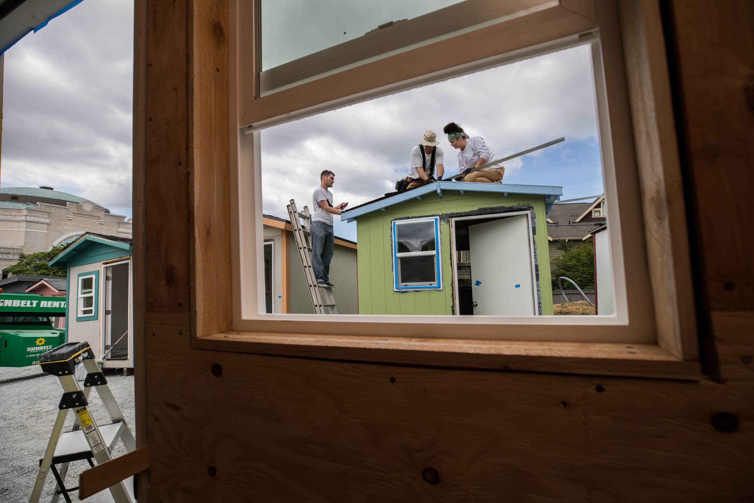
Exclusions & limitations
What are common policy restrictions?

Slide 20
Exclusions & Limitations under the General Liability Policy:
  Exclusions
    Communicable Disease
    Aircraft
    Property
    Childcare and/or Elderly Care
  Limitations
    Events drawing more than 25,000 attendees
    Construction projects where the value of materials (donated or purchased) is $50,000 of more
    Firework displays
Exclusions & limitations
Notes:
This is a brief, not exhaustive, list of exclusions and limitations under the Program. The GL and D&O/EPL insurance policies exclude coverage that is typically provided by other types of insurance, because insurance policies do not duplicate coverage found in other types of insurance policies.

Slide 21
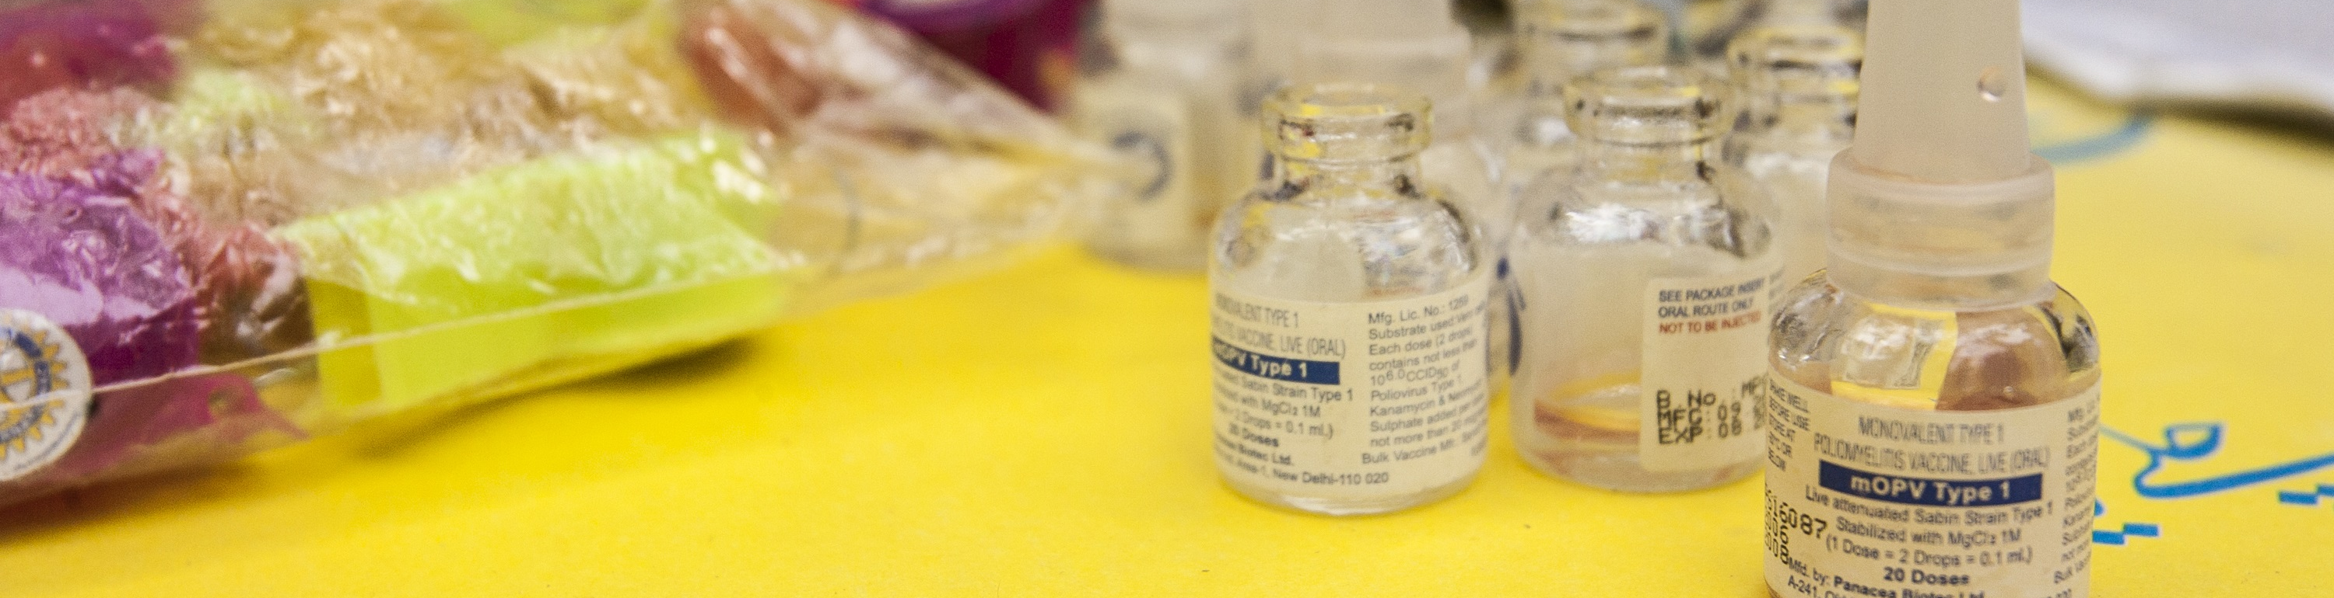
COMMUNICABLE DISEASE - EXCLUSION
The policy does not apply to any liability or any other loss, cost, damage, expense, injury, claim or suit, arising out of, or resulting directly or indirectly, in whole or in part from a communicable disease (including COVID-19).
If your Rotary club or district is presented with a claim, it should still immediately be reported to RI’s Risk Management Department.
Notes:
The policy does not apply to any liability or any other loss, cost, damage, expense, injury, claim or suit, arising out of, or resulting directly or indirectly, in whole or in part from a communicable disease.
Communicable disease means any infectious or contagious substance:
Including, but not limited to, a virus, bacterium, parasite or other organism or any mutation thereof, whether deemed living or not, and
Regardless of the method of transmission, whether direct or indirect, including, but not limited to, airborne transmission, bodily fluid transmission, transmission from or to any surface or object, solid, liquid or gas or between humans, animals, or from any animal to any human or from any human to any animal,
that can cause or threaten damage to human health or human welfare or causes or threatens contamination to property.
If a club or district has a COVID-19 claim, they should still submit it to RI Risk Management. It will be reported to our third-party administrator for further handling and evaluation of coverage.

Slide 22

Aircraft - exclusion
There is no coverage for claims arising out of the use of aircraft.
Aircraft includes, but is not limited to:
Spacecraft
Satellite
Hot Air Balloon
Drone
Missile
Notes:
The Program does not provide coverage for any claims arising out of the use of aircraft. Aircraft includes, but is not limited to, spacecraft, satellite, hot air balloon, drone, or missile. If your Rotary club/district is involved in events with aircraft activities, work with an insurance professional on how to properly protect your club/district from claims and lawsuits that may arise.
If your club or district owns aircraft, separate insurance coverage must be purchased.
Coverage under the Program still exists for non-aircraft related claims (example – if an attendee files a claim for a trip and fall while at a hot air balloon festival, there would be coverage under the Program, subject to policy terms and conditions, as the claim involves a premises exposure and not an aircraft exposure).

Slide 23
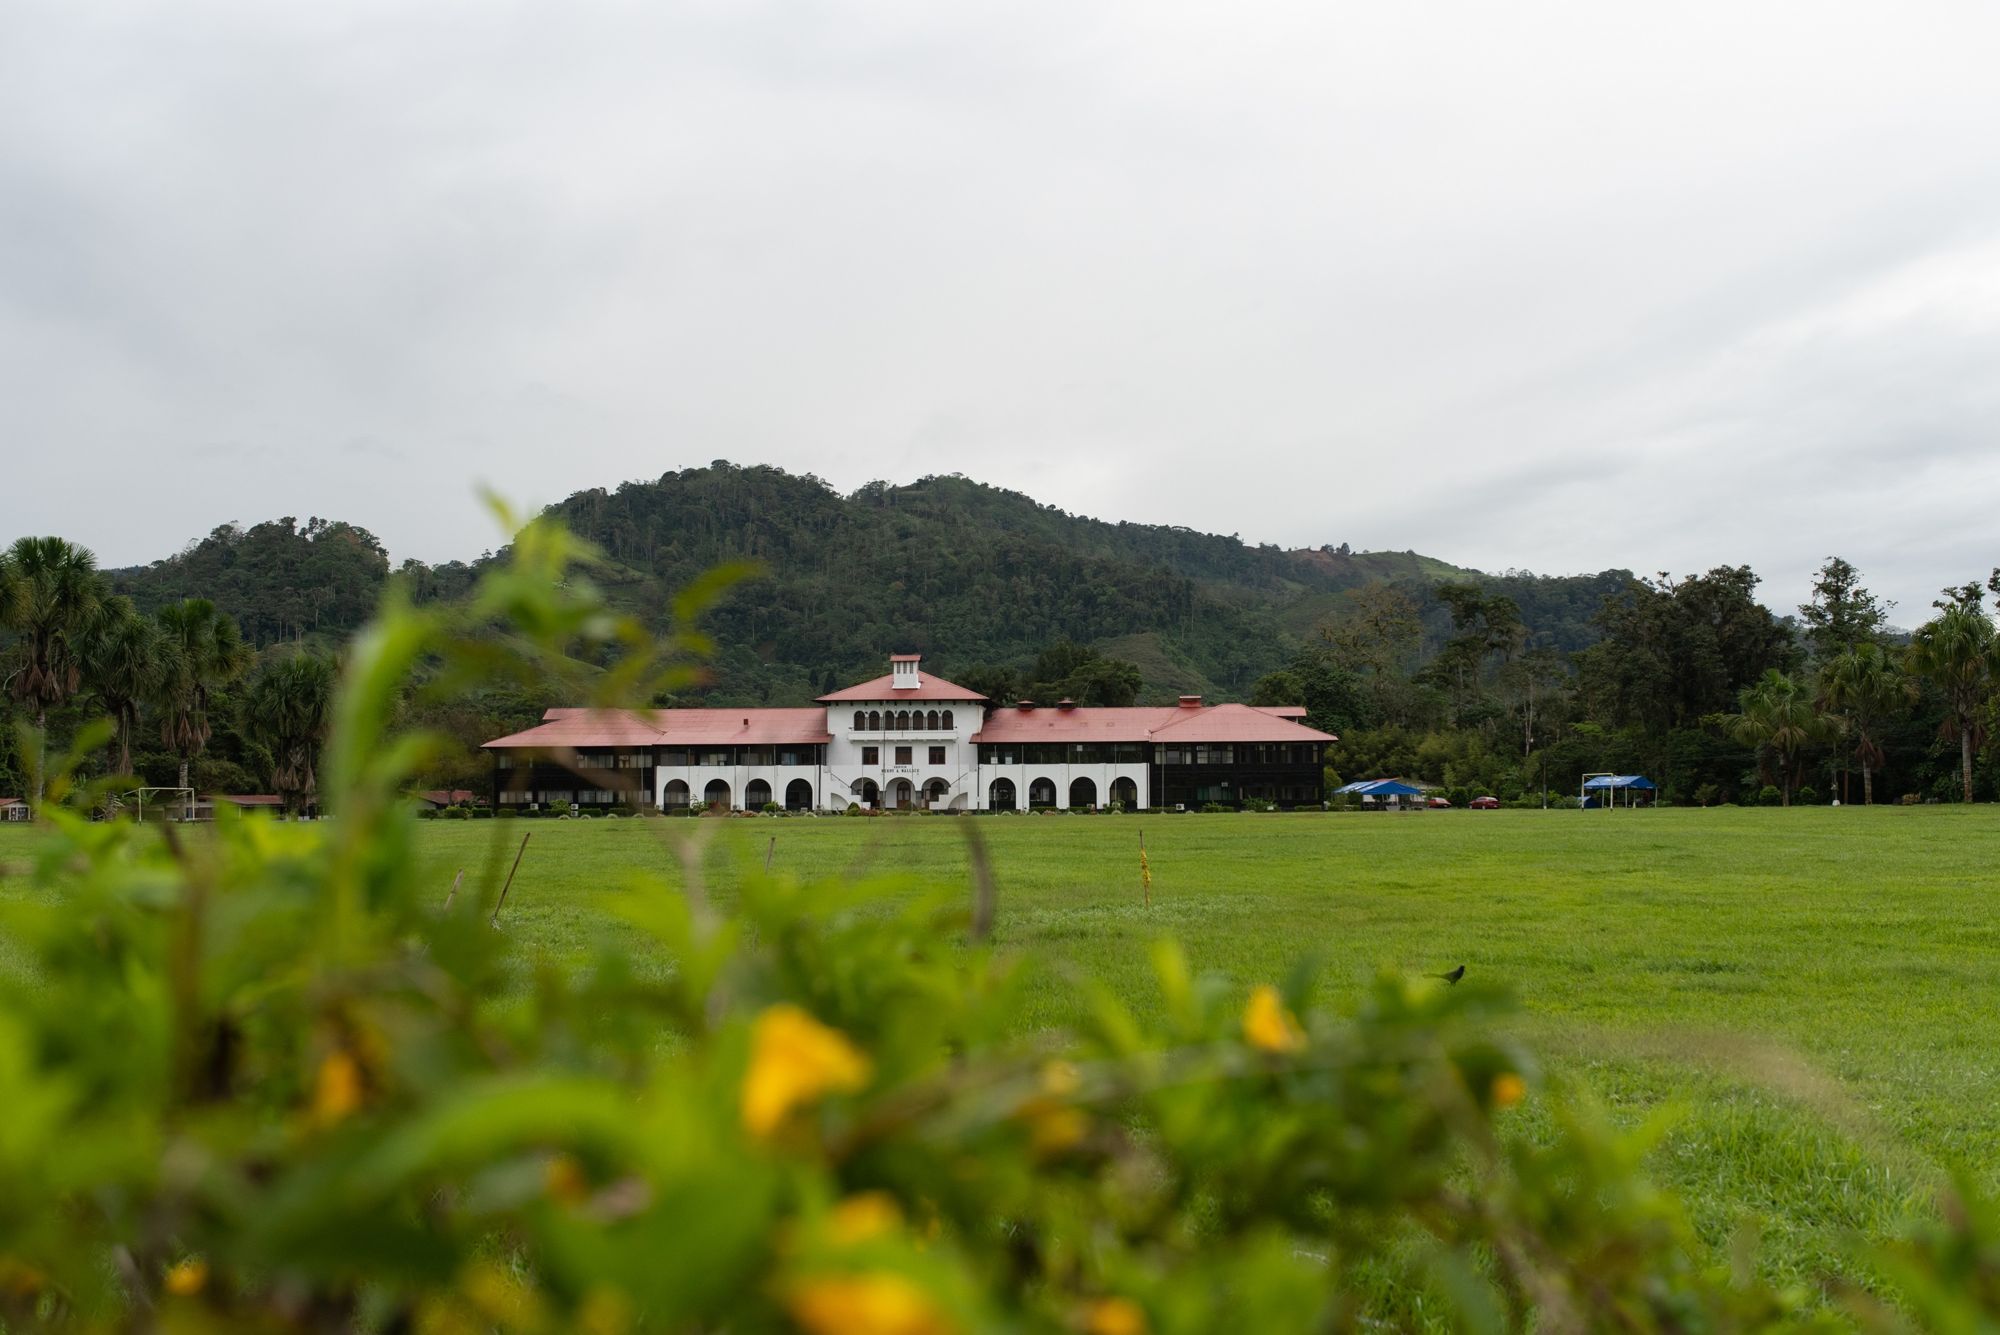
subhead
Property coverage - exclusion
The Program does not provide coverage for property owned, in the care, custody, or control of a club or district, or loss of property or coverage for theft of said property.
Notes:
The Program does not provide coverage for property in the care, custody or control of a Rotary club or district, or their foundations. This includes property owned by a club or district, or loss of property due to theft or embezzlement. The exclusion extends to property that has been donated or gifted to any club or district foundation. If property coverage is needed, please contact a local insurance professional to obtain property insurance.

Slide 24

ELDERCARE & CHILDCARE - EXCLUSION
Designated Services or Operations Exclusion
The Program excludes eldercare services performed at an adult day care center or assisted living facility owned, rented, operated or managed by a Named Insured.
The Program excludes childcare services performed at a licensed childcare facility owned, rented, operated or managed by a Named Insured.
Notes:
The Program excludes eldercare services performed at an eldercare facility such as an adult day care center or assisted living facility owned, rented, operated or managed by a Named Insured. This exclusion does not apply to:
- Meals on Wheels or similar senior meal services;
- Eldercare services provided by Rotary members or volunteers at eldercare facilities that are not owned, rented, managed or operated by a Named Insured; and
- Occasional non-professional services for elders provided by Rotary members or volunteers such as assisting with home repairs or deliveries.
The Program excludes childcare services performed at a licensed childcare facility owned, rented, operated or managed by a Named Insured. This exclusion does not apply to:
Occasional babysitting services provided by Rotary members or volunteers outside of a licensed childcare facility.

Slide 25

subhead
Events that draw more than 25,000 attendees - Limitation
Rotary clubs that organize events exceeding 25,000 attendees over the entire event period are required to purchase a primary general liability policy that includes coverage for all the event’s risks and exposures.
Notes:
Rotary clubs and districts that organize events exceeding 25,000 attendees over the entire event period are required to:
Purchase a primary general liability policy (that includes coverage for your event’s risks/exposures) with a minimum limit of $1M per occurrence / $2M aggregate including liquor liability if applicable to your event.
Contact an insurance agent or broker to discuss insurance needs for your event.
The Program will provide excess insurance over a club or district’s primary insurance policy in the case of a catastrophic loss.
Contact RI Risk Management if your club or district incurs a loss from your event.
Send RI Risk Management a Certificate of Insurance evidencing primary coverage is in place for your club or district’s event.
Email to insurance@rotary.org fax to: 847-556-2147
The Rotary club or district should:
Have an attorney review any contract associated with the event.
Require your club or district be named as an additional insured on a primary and non-contributory basis on any vendor’s applicable insurance policy(ies) and be provided a certificate of insurance.
Agree to indemnify another party only for the acts or omissions of your own club/district.
Avoid indemnifying another party for risks your club cannot or does not control.
The number of attendees may be difficult to ascertain. The insurance underwriters review permit applications, newspaper articles, festival websites, festival budget etc. to estimate the number of attendees and evaluate the event’s risk/exposure. Loss history for your club or district is available upon request.
Most US Clubs and districts do not have multi-day large attendee fund-raising events which present a greater exposure due to:
Large crowd concentration risks
Weather-related risks
Alcohol consumption related risks
Food consumption related risks
Vendor and contractual risks
The Program requires primary coverage for large events due to higher risk/exposure and/or past loss history. If your Rotary club or district simply has a booth at a large event or festival, this requirement does not apply.

Slide 26
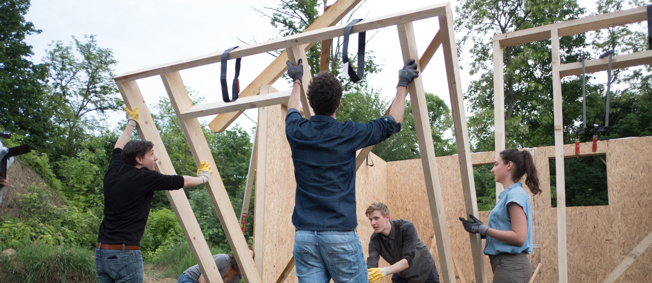
Construction projects - limitation
If a Rotary club or district is involved in a construction project where the value of the materials (donated or purchased) is $50,000 of more, the club or district is required to purchase a primary policy with minimum limits of $1M per occurrence up to the project cost
Notes:
The Program provides limited coverage for liability arising out of bodily injury and property damage to a third party when your club is involved in a large construction project, subject to policy terms and conditions.
If your club or district is involved in a construction project where the value of materials (donated or purchased) is $50,000 or more, your club or district is required to:
Purchase a primary liability insurance policy with minimum limits of $1M per occurrence up to the project cost including products liability and completed operations for 5 years.
Contact an insurance agent or broker to discuss insurance needs for your construction project.
The Program will provide excess insurance over a club or district’s primary insurance policy in the case of a catastrophic loss.
Contact RI Risk Management if your club or district incurs a loss from your event.
Send RI Risk Management a Certificate of Insurance evidencing primary coverage is in place for your project or activity.
Email to insurance@rotary.org fax to: 847-556-2147
The Rotary club or district should:
Have an attorney review any contracts associated with the construction project.
Agree to indemnify another party only for the acts or omissions of your own club/district.
Avoid indemnifying another party for risks your club cannot or does not control;
Be named as an additional insured on a primary and non-contributory basis on the contractor’s applicable insurance policy(ies) and be provided a certificate of insurance;
Have a plan for maintenance once the construction project is done.
If your club or district is involved in a smaller construction, repair or rehab project, the Program insurance coverage remains in place for your club or district. Continue to provide training for your volunteers, when appropriate. All volunteers should sign waiver and release forms, to confirm they understand and acknowledge the risks associated with the activity. Volunteers should carry their own health and property insurance.
For your construction project remember that damage to property (such as equipment, materials, personal property) in the care, custody or control of an Insured is excluded.
On Gallagher Insurance Website please review Loss Prevention Strategies – Construction Projects and Waivers and Releases.

Slide 27

subhead
Firework displays - limitation
If a Rotary club or district hires a pyrotechnic firm or other similar company to detonate fireworks, the Rotary club or district is required to purchase a primary general liability policy with a minimum limit of $5M per occurrence.
Notes:
If a Rotary club enters into a contract with a pyrotechnic firm or other company to detonate fireworks, your club or district is required to:
Purchase a primary general liability policy with a minimum limit of $5M per occurrence.
Contact an insurance agent or broker to discuss insurance needs for your event.
The Program will provide excess insurance over a club or district’s primary insurance policy in the case of a catastrophic loss.
Contact RI Risk Management if your club or district incurs a loss from your event.
Send RI Risk Management a Certificate of Insurance evidencing primary coverage is in place for your club or district’s event.
Email to insurance@rotary.org fax to: 847-556-2147
The pyrotechnics firm hired by the Rotary club or district must have a general liability policy with minimum limits of $5M per occurrence or the minimum limits required by the city/municipality, whichever amount is greater.
The Rotary club or district should:
Have an attorney review the contracts associated with the pyrotechnic firm;
Be named as an additional insured on a primary and non-contributory basis on the pyrotechnic firm’s applicable insurance policy(ies) and be provided a certificate of insurance;
Avoid indemnifying the pyrotechnic firm for risks your club cannot or does not control.
Claims arising out of pyrotechnic events can be very costly. A prior claim arose out of misfired fireworks that injured approximately 100 people resulting in a total claim cost exceeding $7M. Because the Rotary club was named as an additional insured on the pyrotechnics firm’s $10M policy, the Program and the Rotary club were not impacted by this loss.
This requirement does not apply if your club or district’s role is to sponsor or provide funding for the fireworks, and another party, such as a municipality or chamber of commerce, signs the contract to hire the pyrotechnic firm.
With respect to the "sale" of fireworks, there is coverage under the Program, subject to policy terms and conditions, for the “legal sale for fundraising purposes of pre-wrapped fireworks purchased from a licensed third party.” On Gallagher Insurance Website see Loss Prevention Strategies – Use of Fireworks.

Slide 28
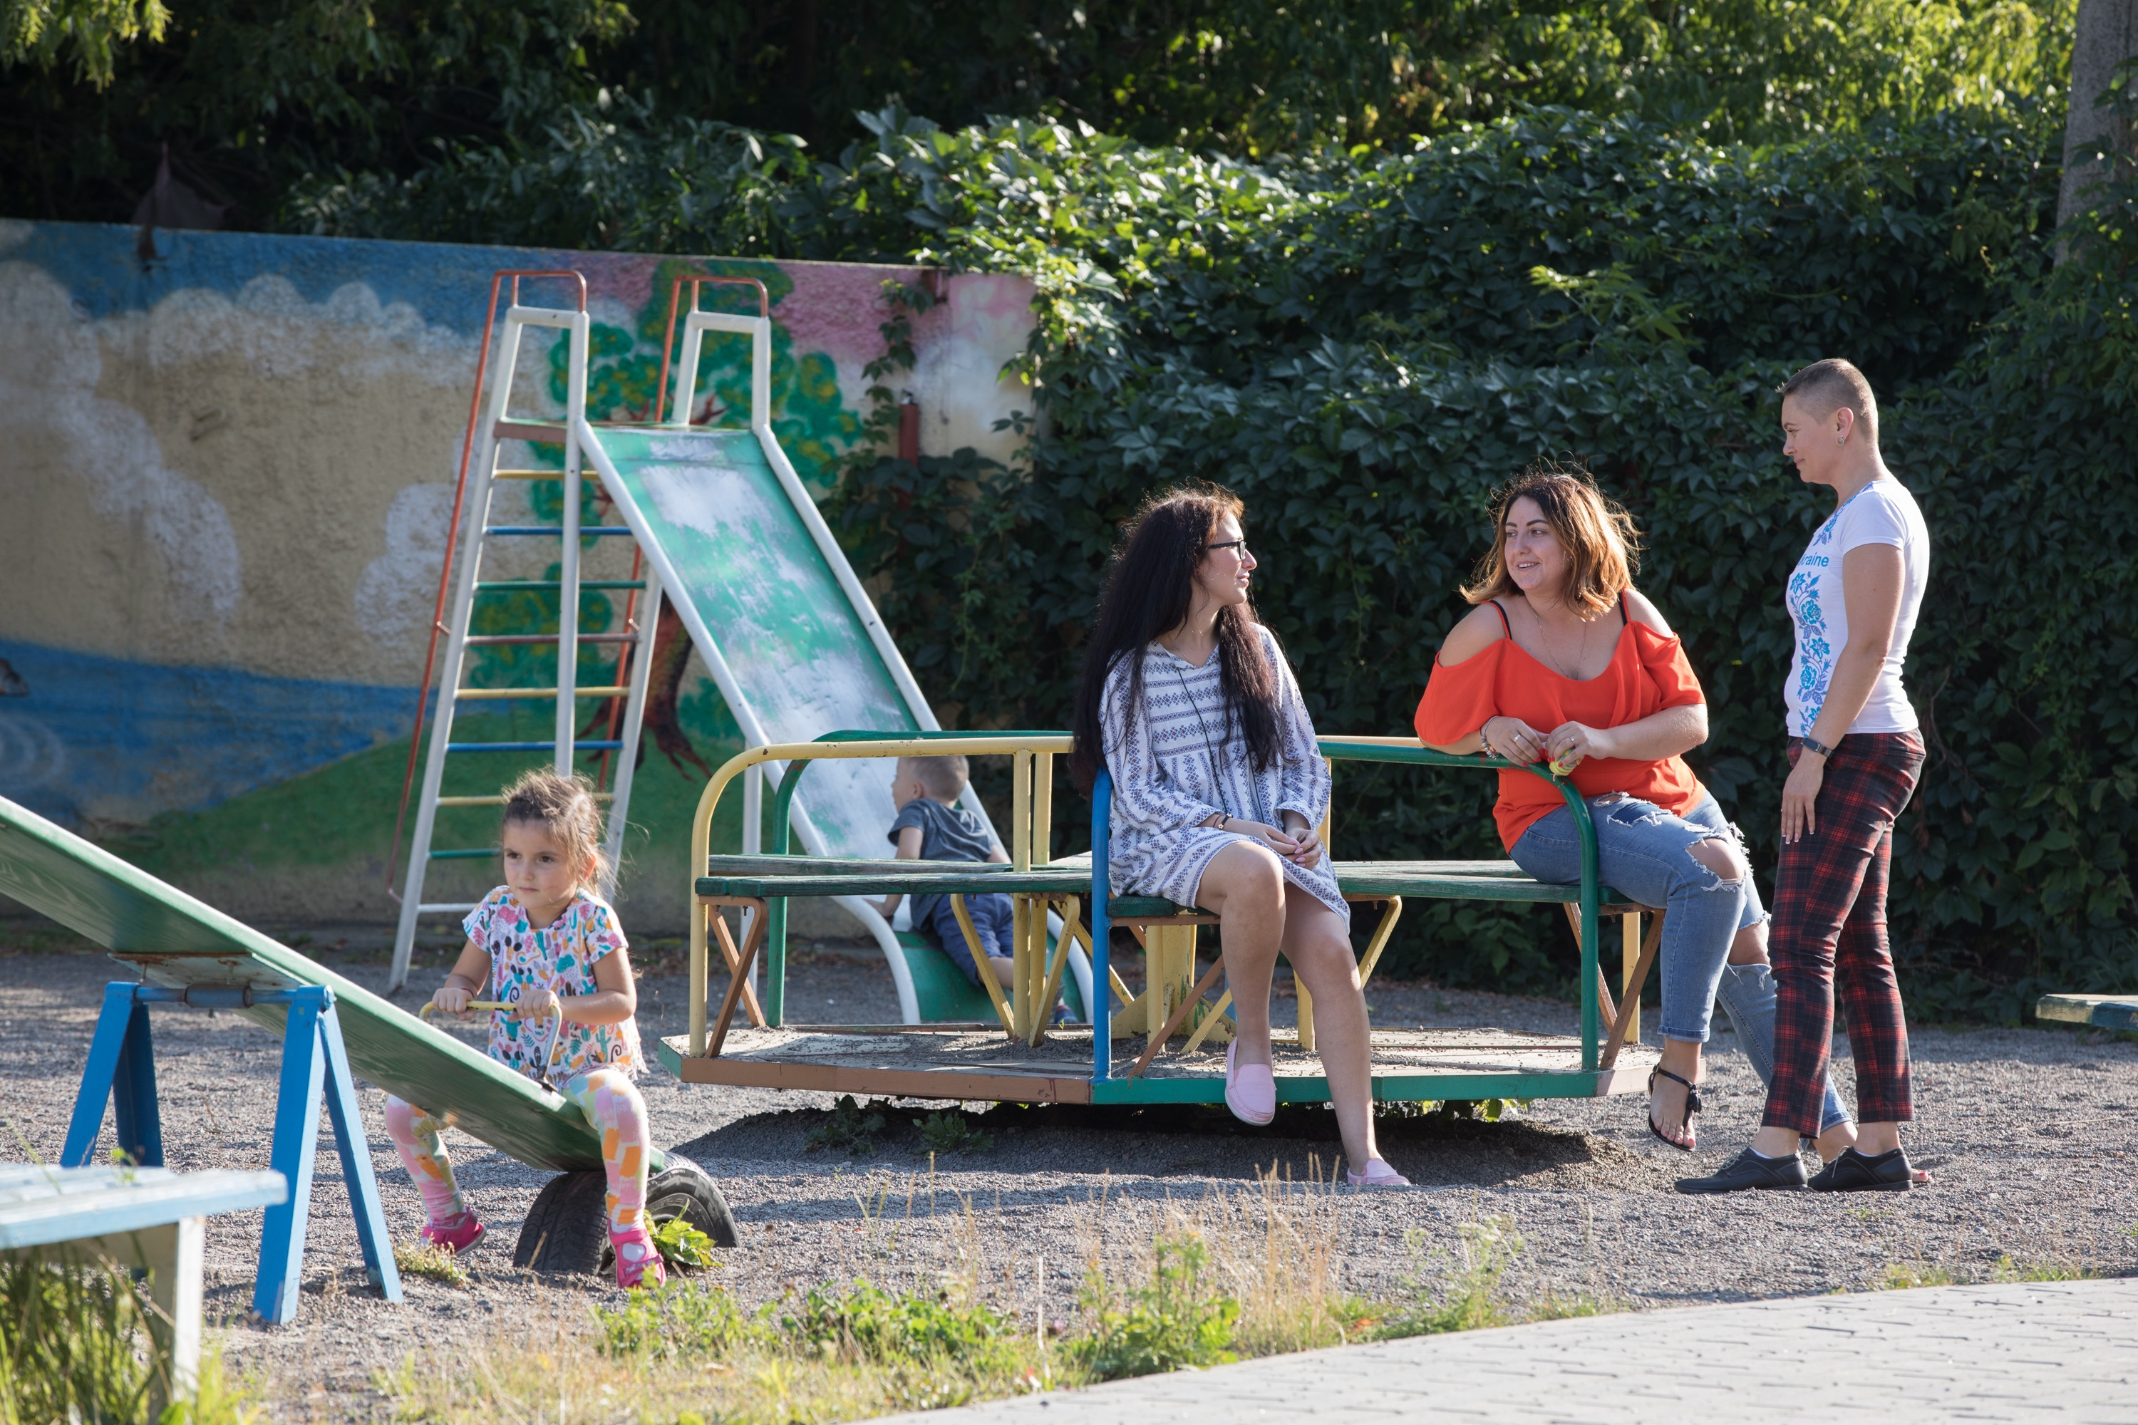
Incident reporting
What should your club or district do when an incident happens?

Slide 29
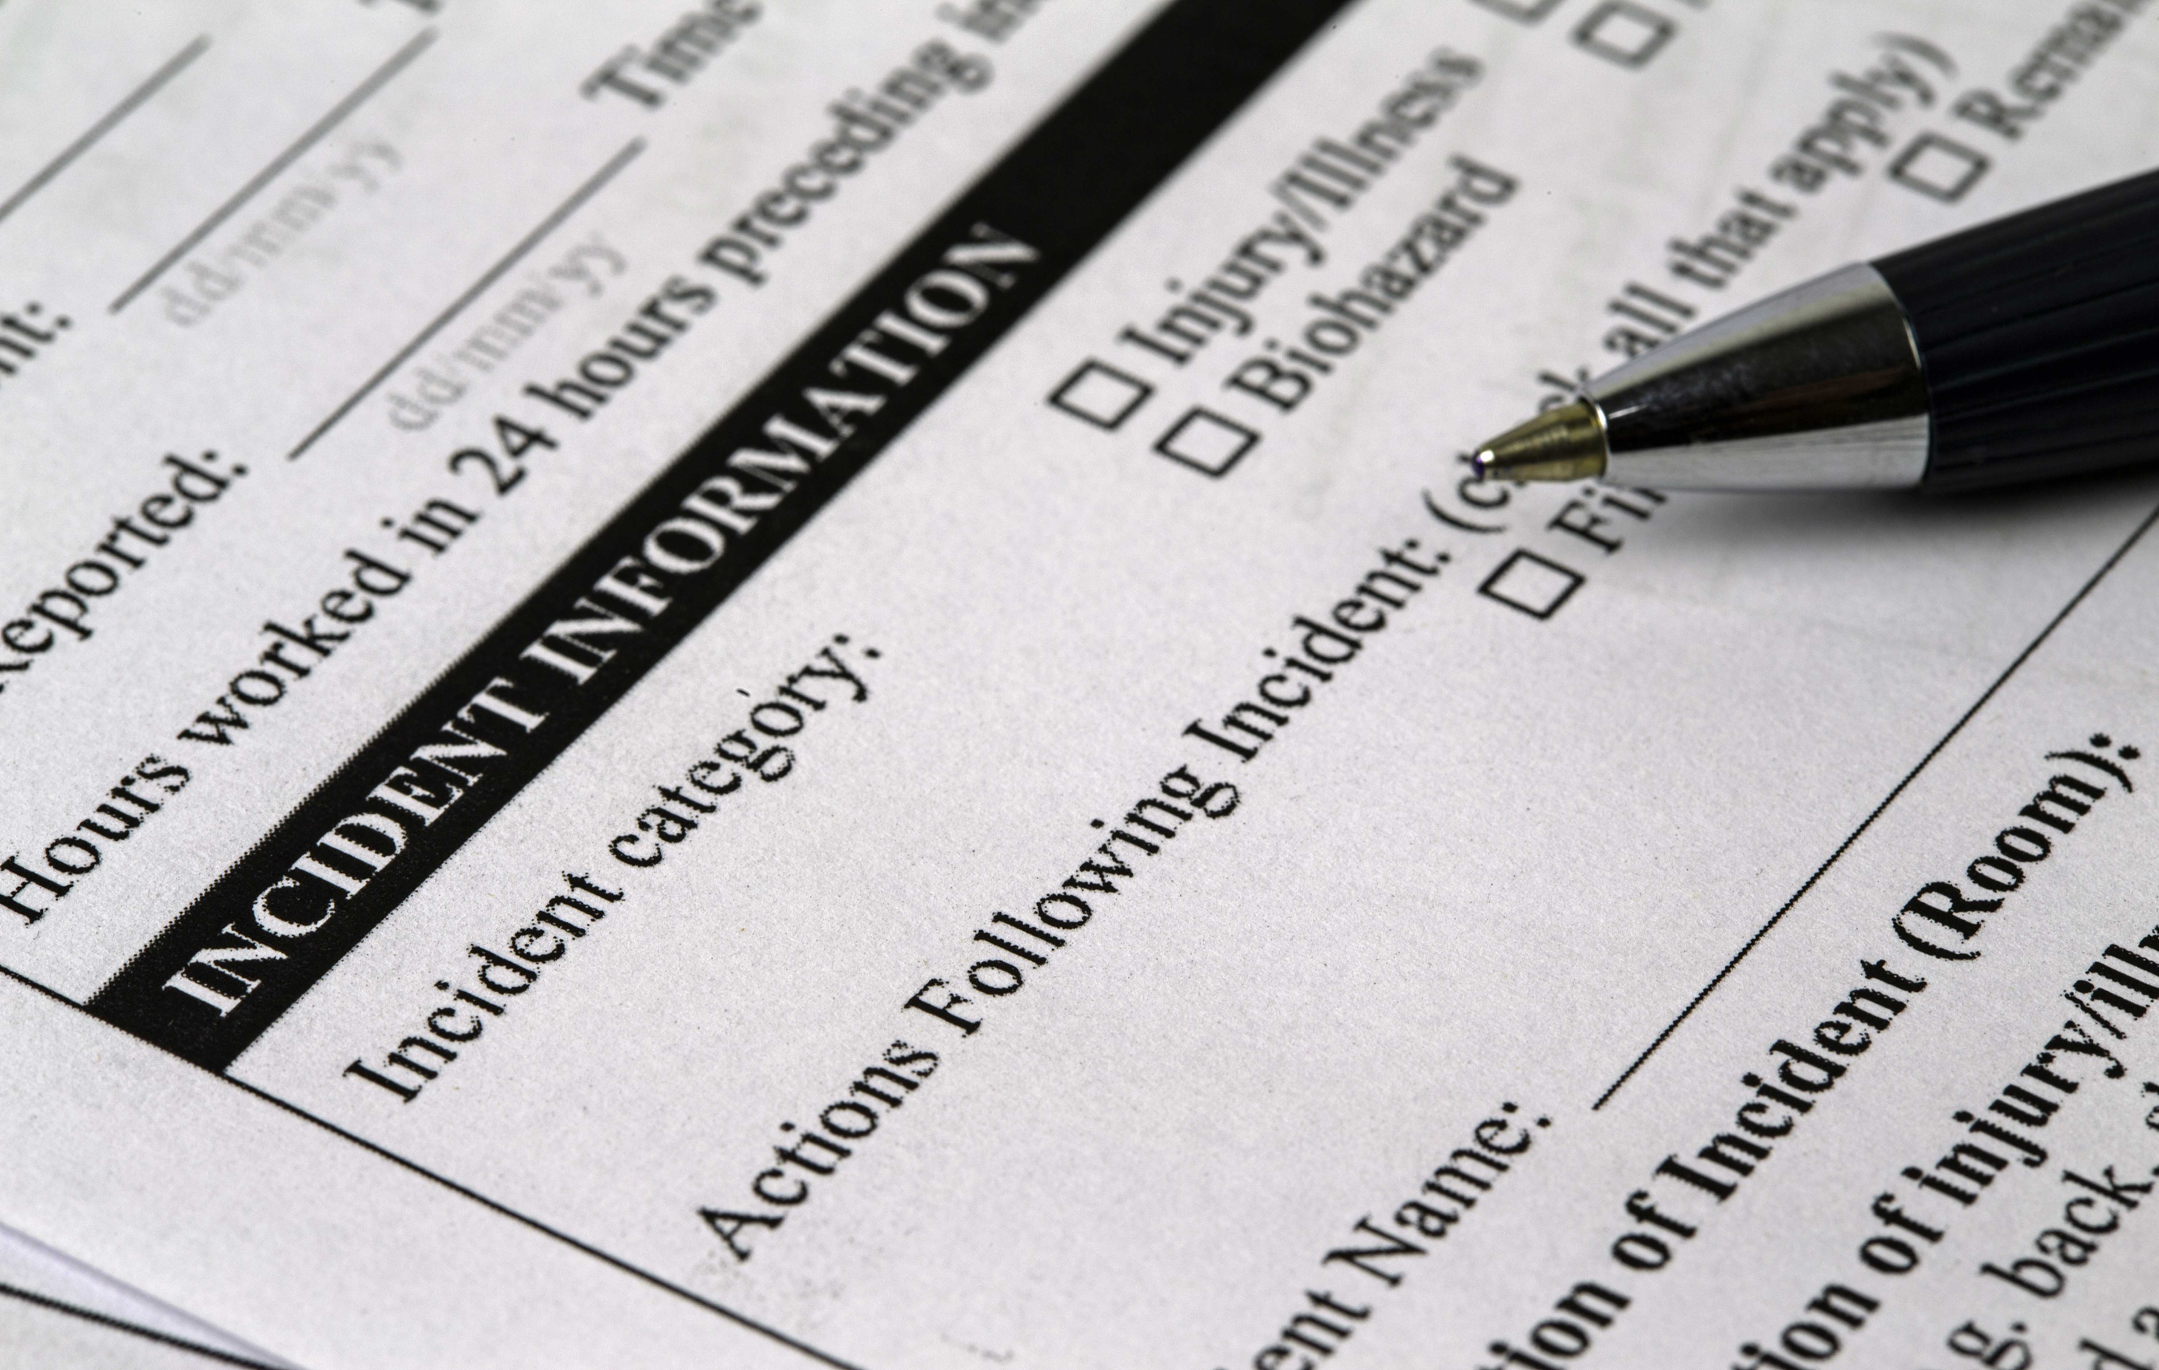
subhead
Incident reporting information
SCREEN SHOT OF NEW WEBSITE HERE
What to do if you are notified of an incident/claim or lawsuit
Report to RI’s Risk Management Immediately
Obtain and complete an Incident Report Form
Notes:
Please immediately report all incidents and/or losses to Risk Management. The Incident Report form is on Gallagher Insurance Website and can be submitted to Risk Management by email to claims@rotary.org or by fax to (847) 556-2147. An Incident Report is notice of an occurrence/loss that may or may not lead to a compensable claim. If the incident involves serious injury or death, please notify Risk Management immediately.
Do not voluntarily promise insurance coverage, make payments, or assume any financial obligation, other than providing first-aid, without the insurance company’s consent as you could jeopardize your insurance coverage.
The sooner Risk Management knows about an incident; the sooner the incident can be investigated. Complete the incident report form while the facts are fresh in your mind. Include all documentation related to the event when sending in your incident report form. If you are aware of an injury arising out of your club’s event, please report it even if your club has not been contacted by the injured person or received notice of a claim relating to the incident.

Slide 30
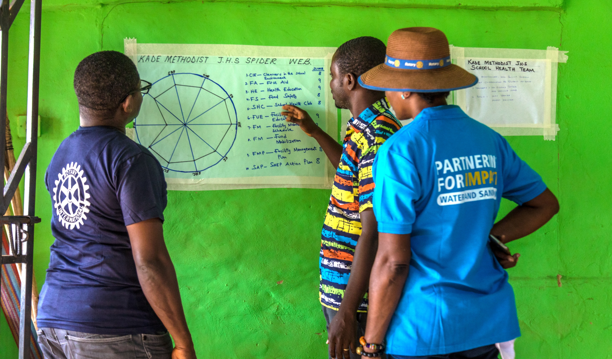
resources
Where should you go to obtain more information about the Program?

Slide 31
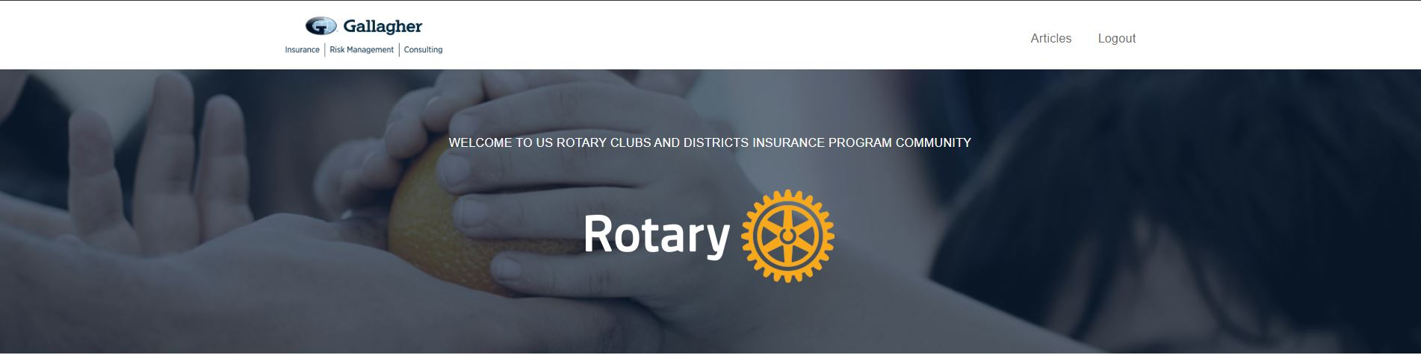
31
RESOURCES
Gallagher (insurance broker)
  Gallagher Insurance Website: https://rotary.ajg.com/
  Toll Free: 1-833-3ROTARY
  1-833-376-8279
  Email: rotary@ajg.com
RI’s Risk Management Department
  Email: insurance@rotary.org
  claims@rotary.org
  E-mailings from Risk Management to Club & District Officers throughout the year
Notes:
Rotarians have various means of obtaining information relating to the Insurance Program.
Internal to RI - Rotary Publications: Lead Your Clubs, Lead Your District – includes general information about the US Rotary Club & District Insurance Program
Insurance Broker (Gallagher) Insurance Portal – accessible to all U.S. Rotarians – Gallagher Insurance Website – contains insurance and risk management documents including: certificate of insurance, incident report form, loss prevention strategies, policies, policy summaries, Frequently Asked Questions, and other announcements or documents relevant to the Insurance Program.
Insurance Broker –email address & toll-free phone number staffed by dedicated team of insurance professionals who issue Additional Insured endorsements and answer insurance questions and inquiries
RI Risk Management – dedicated email address for insurance inquiries (insurance@rotary.org) and claims (claims@rotary.org)
E-mailings from Risk Management throughout the year – annual mailings to club and district officers, providing information about insurance, the Insurance Portal, and other information relevant to club activities

Slide 32
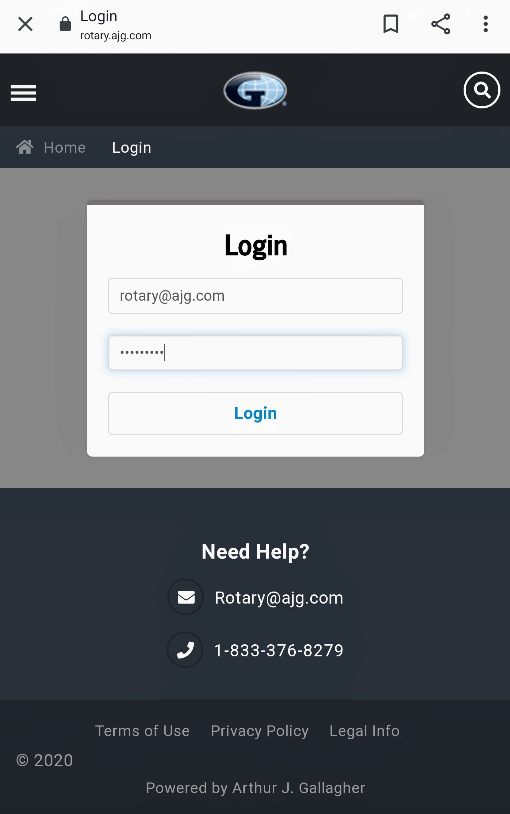
subhead
Gallagher Insurance website
https://rotary.ajg.com
Username: rotary@ajg.com
Password: rotarian1
What is available on the Portal?
Certificate of Insurance
Summary of Coverage
Loss Prevention Strategies
Incident Forms
And more!
The website is accessible via mobile devices

Slide 33
Presentation was prepared by Rotary International’s Risk Management Department.
QUESTIONS
Please contact:
insurance@rotary.org
Nothing in this presentation shall be construed to extend, alter, vary, or waive any of the provisions of the actual insurance policies.
While information may be presented to help explain coverage, it does not alter or change how the insurance policy will apply in the event of a claim.

